Slide 1
COMPILER CONSTRUCTION
A Simple Compiler
Chia-Heng Tu
Dept. of Computer Science and Information Engineering
National Cheng Kung University
Spring 2018

Slide 2
Chapter 2
Design of a Simple Compiler

Slide 3
Overview
In this chapter, we will describe:
  a simple programming language, adding calculator (ac), &
  a simple compiler for ac
The ac compiler translates the ac program into the corresponding desk calculator (dc) program
  which is a stack-based calculator
  Stack-based languages commonly serve as targets of translation
    They lend themselves to compact representation
    Examples: Java → Java Virtual Machine, ActionScript → AVM2 for Flash media, printable documents → PostScript

Slide 4
Key Concepts for the ac Compiler
Regular expressions
  For basic symbols of ac
Context-free grammar (CFG)
  For syntax of ac
Parse tree
Scanning
Parsing
Abstract Syntax Trees
Semantic Analysis
Code generation

Slide 5
Token
Regular Expression for Token
  The actual input characters that correspond to each terminal symbol (called token) are specified by regular expression, which is covered in Ch.3
For example:
  assign symbol is a terminal, which appears in the input stream as “=“ character
  The terminal id (identifier) could be any alphabetic character
    Note f, i, and p are reserved for special use in ac
    It is specified as [a-e] | [g-h] ] | [j-o] | [q-z]

Slide 6
Token (Cont’d)
Recognize tokens via regular expression rules
Examples:
  Reserved keywords: f, i, and p
  ‘|’ is used to specify the union of four sets for id
  One or more decimal digits for inum

Slide 7
Syntax for ac
A context-free grammar (CFG) specifies the syntax of a language
  CFG is used to describe the acceptable statements for the language
  CFG is further described in Ch.4
Now, we can view a CFG simply as a set of productions (or rewriting rules)
Order matters!!!

Slide 8
Syntax for ac: Stmt Example
Stmt→ id assign Val Expr (1)
| print id (2)
Stmt serves the same role in each of the productions separated by ‘|’
These productions indicate that a Stmt can be replaced by one of two strings of symbols
  (1) Stmt is rewritten by symbols that represent assignment to an identifier
  (2) Stmt is rewritten by symbols that print an identifier’s value

Slide 9
Productions
Two kinds of grammar symbols (in Productions):
  A terminal cannot be rewritten, a.k.a. token
  E.g., id, assign, and $ symbols have no productions
  A non-terminal can be rewritten by a production rule
  E.g., Val and Expr
A special non-terminal is start symbol
  which is usually the symbol on the left-hand side (LHS) of the grammar’s first rule, e.g., Prog
From the start symbol, we proceed to generate a program
  by replacing (rewriting) a symbol on LHS with the right-hand side (RHS) of some production of that symbol

Slide 10
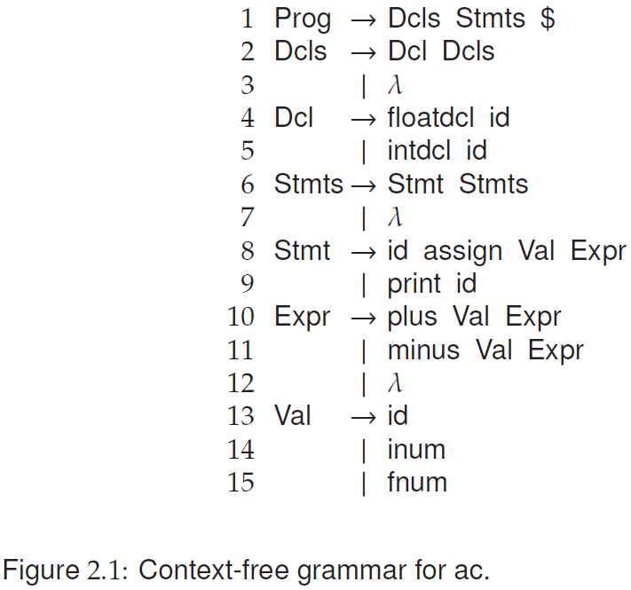
Productions (Cont’d)
A special symbol λ denotes empty or null string
  which indicates that there are no symbols on a production’s RHS
The special symbol $ represents the end of the input stream

Slide 11
Productions (Cont’d)
For an ac program, we continue rewriting non-terminals by applying production rules against CFG until none of non-terminals remains
  Example shown in the next page
  Any string of terminals that can be produced in this manner is considered syntactically valid
  Any other string has a syntax error and would not be a legal program
Notice that some productions in a grammar serve to generate an unbounded list of symbols from a nonterminal using recursive rules
  E.g., Stmts→Stmt Stmts (Rule 6) allows an arbitrary number of Stmt symbols to be produced
  The recursion is terminated by applying Stmts→λ (Rule 7)

Slide 12
Example ac program
Given the example ac program
We apply the grammar rules in Fig. 2.1 to see if it is a valid program
f b i a a = 5 b = a + 3.2 p b

Slide 13
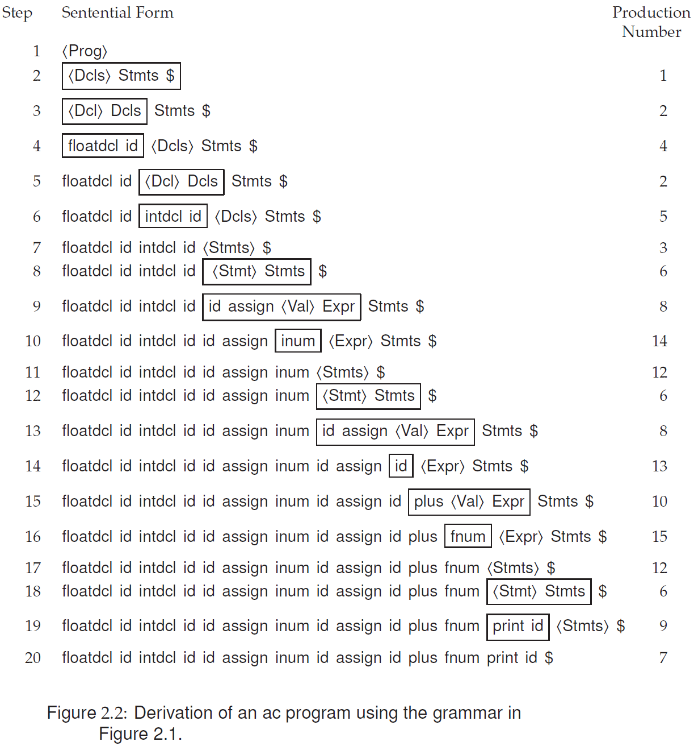

Example of the Derivation of One ac Program
f b i a a = 5 b = a + 3.2 p b

Slide 14
Parse Tree of the ac Program
The derivation shown textually in previous page can be represented as a derivation (or parse) tree shown here
Yes. The ac program is valid
ac program

Slide 15
Parse Tree of the ac Program (Cont’d)

Slide 16
Phases of the ac Compiler
Regular expressions
  for basic symbols of ac
Context-free grammar (CFG)
  For syntax of ac
Parse tree
Scanning
Parsing
Abstract Syntax Trees
Semantic Analysis
Code generation

Slide 17
An Informal Definition of ac
Types
  Most programming languages offer a significant number of predefined data types, with the ability to extend existing types or specify new data types
  In ac, there are only two data types: integer and float
  An integer type is a sequence of decimal numerals, as found in most programming languages
  A float type allows five fractional digits after the decimal point
Keywords
  Most programming languages have a number of reserved keywords, such as if and while, which would otherwise serve as variable names
  In ac, there are three reserved keywords, each limited for simplicity to a single letter:
    f (declares a float variable), i (declares an integer variable), and p (prints the value of a variable)
Variables
  Some programming languages insist that a variable is declared by specifying the variable’s type prior to using the variable’s name
  The ac language offers only 23 possible variable names, drawn from the lowercase Roman alphabet and excluding the three reserved keywords f, i, and p
  Variables must be declared prior to using them
Check Figure. 2.3 for formal definition of ac tokens

Slide 18
Scanning
The scanner reads a source ac program as a text file and produces a stream of tokens
Each token has the two components:
  1)Token type explains the token’s category, e.g., id
  2)Token value provides the string value of the token, e.g., “b”
Methods:
  PEEK(): a single character of lookahead
  ADVANCE(): the scanner is moved to the next input character (using advance), which suffices to determine the next token

Slide 19
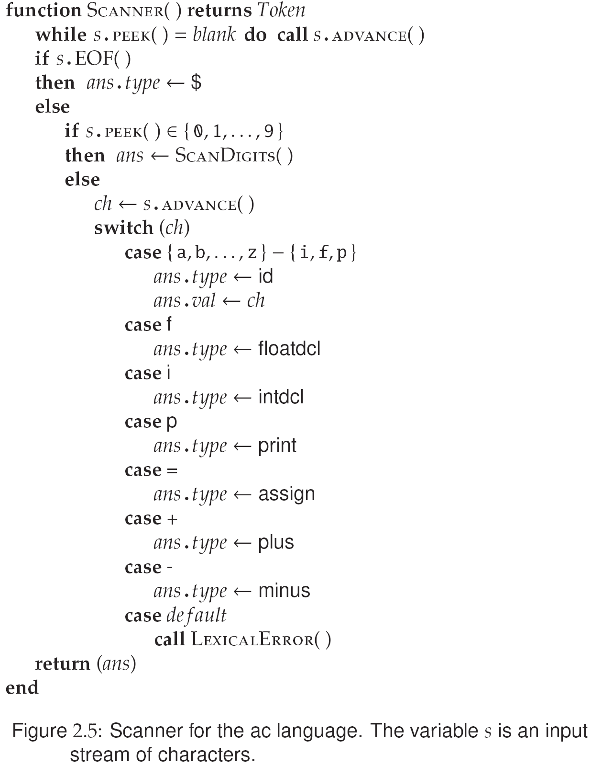
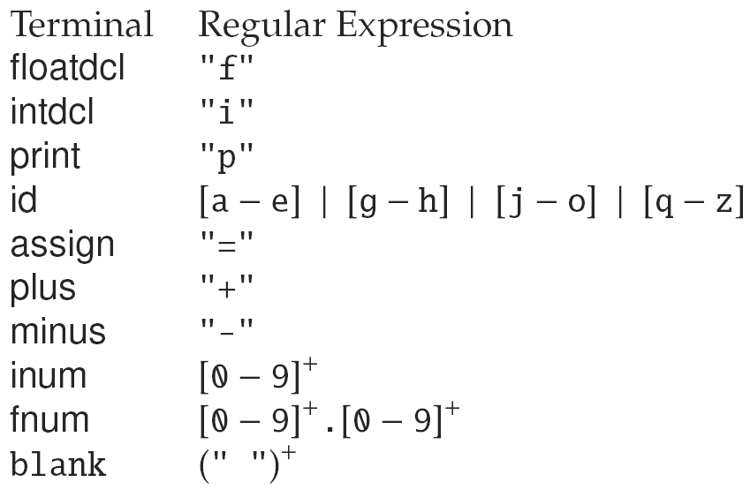
Scanner for ac
The figure shows a scanner that finds all tokens for ac
Pseudo code for ac scanner
  A big case-switch to choose the type for the character of the input stream
  Referencing the token definition below

Slide 20
Scanner for ac
Given the input stream:
  i a a = 32 p a
We show how scanner to get the token i
Input stream:
i a a = 32 p a
s

Slide 21
Scanner for ac
Given the input stream:
  i a a = 32 p a
We are at i, and we show how scanner
  skip the blank and
  recognizes id (a)
Input stream:
i a a = 32 p a
s
s

Slide 22
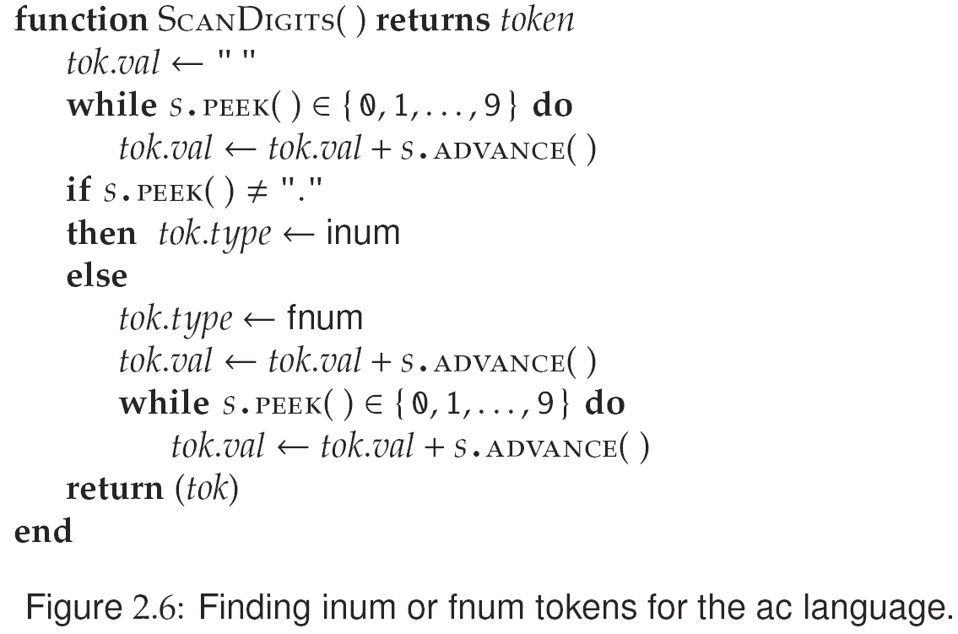
Scanner for ac (Numbers)
The figure shows scanning a number token
Handle a number
  Type:
    Integer
    Float
  Its Value

Slide 23
You May Know by Now…
Source code of language N
Scanner
generator
Tokens
N’s Compiler
Parser
generator
Grammars
Compiled code for the input program
Given a new language, N
  The figure shows the flow of constructing a compiler for N
  Define the Tokens and Grammars for N, and
  build N’s scanner and parser with the Tokens and Grammars, which produce N’s compiler
You can build the compiler for L
  by given the tokens and grammars of another language, L

Slide 24
Parsing
Parser
  processes tokens produced by the scanner,
  determines the syntactic validity of the token stream, &
  creates an abstract syntax tree (AST) for subsequent phases
In most compilers, the grammar serves
  not only to define the syntax of a programming language,
  but also to guide the automatic construction of a parser

Slide 25
Parsing Technique
Recursive descent is one simple parsing technique used in practical compilers
  The name is taken from the mutually recursive parsing routines that descend through a derivation tree
  In recursive-descent parsing, each nonterminal in the grammar has an associated parsing procedure
    that is responsible for determining if the token stream contains a sequence of tokens derivable from that nonterminal

Slide 26
Actually, Mutual Recursion Refers to …
Mutual recursion is a form of recursion
  where two mathematical or computational objects are defined in terms of each other
  such as functions or data types
Example
  Determine whether a non-negative number is even or odd?
  It is done by defining two separate functions that call each other, decrementing each time
bool is_even(unsigned int n) {
if (n == 0)
return true;
else
return is_odd(n - 1);
}
bool is_odd(unsigned int n) {
if (n == 0)
return false;
else
return is_even(n - 1);
}
Courtesy of https://en.wikipedia.org/wiki/Mutual_recursion

Slide 27
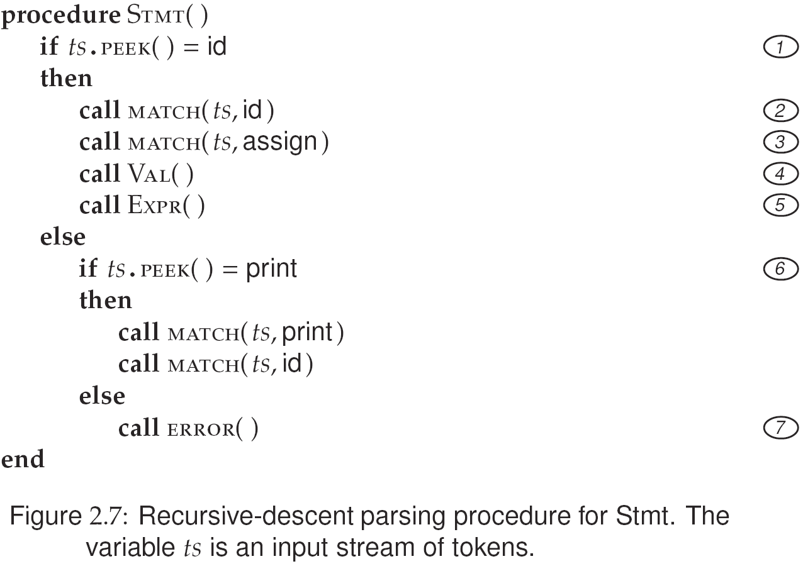
Recursive-Descent Parsing
Each parsing procedure examines the next input token to predict which production to apply
Example:
The parsing procedure
for Stmt shown in Fig. 2.7
  Stmt → id assign Val Expr
  Stmt → print id

Slide 28
Recursive-descent Parsing (Cont’d)
If id is the next input token, the parse proceeds with the production:
Stmt → id assign Val Expr
and the predict set for the production is {id}
If print is the next, the parse proceeds with:
Stmt → print id
the predict set for the production is {print}
If the next input token is neither id nor print, neither rule can be applied; it calls ERROR

Slide 29
Recursive-descent Parsing (Cont’d)
Computing the predict sets used in Stmt is relatively easy
  since each production for Stmt begins with a distinct terminal symbol: id or print

Slide 30
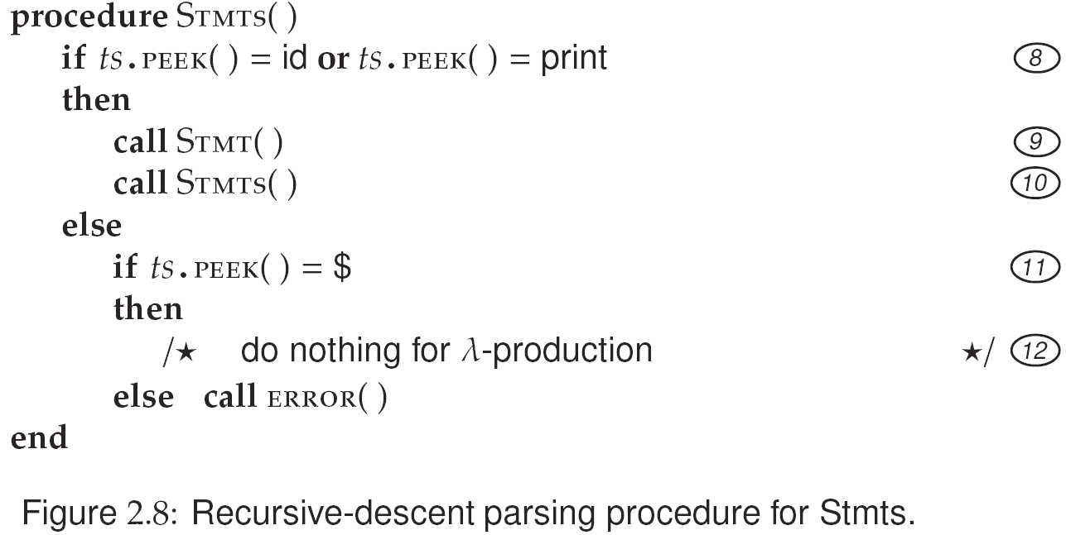
Recursive-descent Parsing (Cont’d)
Consider the productions for Stmts:
  Stmts → Stmt Stmts
  Stmts → λ
  The predict sets for Stmts can be computed by inspecting the following:
  Stmts → Stmt Stmts begins with the non-terminal Stmt
    Find those symbols that predict any rule for Stmt (i.e., first symbols in Stmt)
    Check for id or print as the next token
  Stmts → λ derives no symbols
    Look for what symbol(s) could occur following such a production
    In this case, it is $ (→ Rule 1 in Fig. 2.1)
The analysis required to compute predict sets in general is covered in Ch.4 and Ch.5

Slide 31
Recursive-descent Parsing (Cont’d)
When a terminal such as id is encountered, a call to MATCH(ts, id) is placed into the code
  The MATCH procedure simply consumes the expected token id if it is indeed the next token in the input stream
  The next call to MATCH(ts, assign) tries to match assign
The last two symbols in Stmt→id assign Val Expr are nonterminals
  Later, calls to Val() and Expr() are performed
You may try to think about how Stmts is parsed (Check Sec. 2.5.2)

Slide 32
Abstract Syntax Tree (AST)
The scanner and parser together
  accomplish the syntax analysis phase of a compiler
  ensure that the compiler’s input conforms to a language’s token and CFG specifications
Parse tree
  might be considered as the structure that survives syntax analysis and is used for the remaining phases
  However, such trees can be rather large and unnecessarily detailed, even for very simple grammars and inputs

Slide 33
Abstract Syntax Tree (AST) (Cont’d)
Abstract syntax tree
  contains the essential information from a parse tree,
  but inessential punctuation and delimiters (braces, semicolons, parentheses, etc.) are not included
It serves as a representation of a program for all phases after syntax analysis
  It is actually the data structure kept in memory to represent the program code during compilation
  Such phases may make use of information in the AST, decorate the AST with more information, or transform the AST

Slide 34
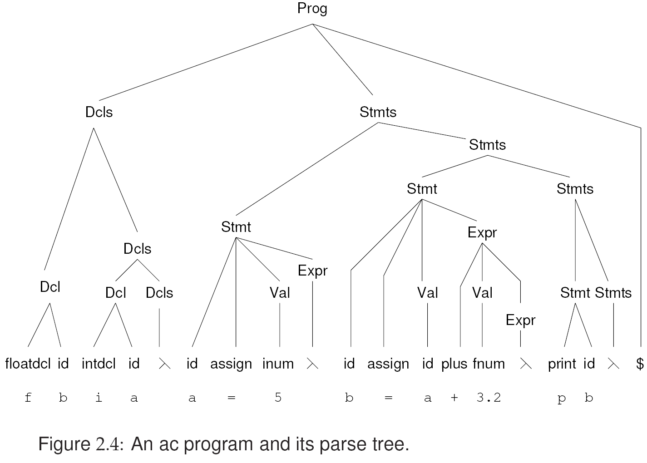
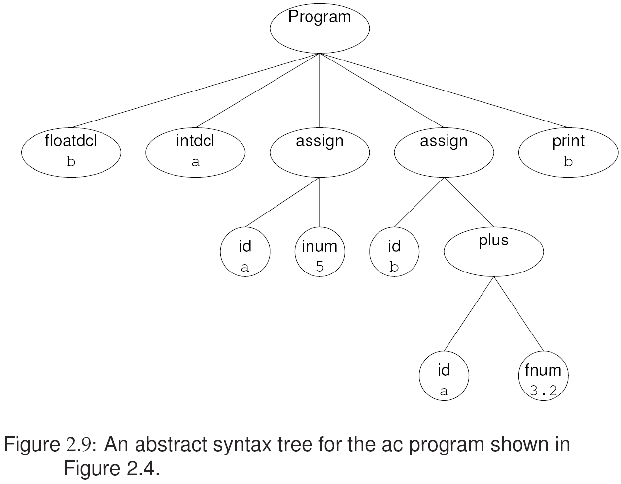
Abstract Syntax Tree (AST) (Cont’d)
Consider the expression a+3.2
  8 nodes for parse tree (Fig. 2.4)
  3 nodes for AST (Fig. 2.9)
  Check Sec. 2.6 for rules to translate from parse tree to AST

Slide 35
Semantic Analysis
Is a catchall term for any post-parsing processing
  that enforces aspects of a language’s definition that are not easily accommodated by syntax analysis
Examples (Two examples are introduced below):
  Declarations and name scopes are processed to construct a symbol table, so that declarations and uses of identifiers can be properly coordinated
  Language- and user-defined types are examined for consistency
  Operations and storage references are processed so that type-dependent behavior can become explicit in the program representation

Slide 36
Semantic Analysis Example: Symbol Table
Symbol-table construction is a semantic processing activity
  that traverses the AST to record all identifiers and their types in a symbol table
In ac, identifiers must be
declared prior to use
  but this requirement is not easily enforced during syntax analysis
→ A separate pass to build the table
f b i c a = 5 p b ← Syntactically correct, but something goes wrong.

Slide 37
Build Symbol Table for ac
We traverse the AST
  counting on the presence of a symbol-declaring node to trigger appropriate effects on the symbol table
  Correspondingly, nodes such as floatdcl and intdcl implement an interface called SymDeclaring,
  which implements a method to return the declared identifier’s type
In Fig. 2.10
  visit(SymDeclaring n) shows the code to be applied at nodes that declare symbols
  EnterSymbol checks that the given identifier has not been previously declared

Slide 38
Symbol Table for ac
In ac, a program can mention at most 23 distinct identifiers
The built symbol table for ac
  with 23 entries
  Each contains symbol and type
  Type: integer, float, or unused (null)
On the contrary
  most languages have infinite potential identifiers
  The type information may include other attributes
  such as, the identifier’s value, scope of visibility, storage class, and protection properties

Slide 39
Semantic Analysis Example: Type Checking
Most programming language specifications include a type hierarchy
  which compares the language’s types in terms of their generality
Example:
A float type is considered wider (i.e., more general) than an integer (Java, C, and C++)
  Every integer can be represented as a float
  On the other hand, narrowing a float to an integer loses precision for some float values

Slide 40
Type Checking
Most languages allow automatic widening of type
  E.g., an integer can be converted to a float without the programmer having to specify this conversion explicitly
  int a;
  float b, c;
  c = a+b; //(automatically type casting for a)
On the other hand, a float cannot become an integer in most languages
  unless the programmer explicitly calls for this conversion

Slide 41
Type Checking for ac
Two types defined in ac
  I.e., integer and float, and
  all identifiers must be type-declared in a program before they can be used
Once the symbol table has been constructed,
  the declared type of each identifier is known, and
  the executable statements of the program can be checked for type consistency
  Type checking
  Refers to the process that walks the AST bottom-up, from its leaves toward its root

Slide 42
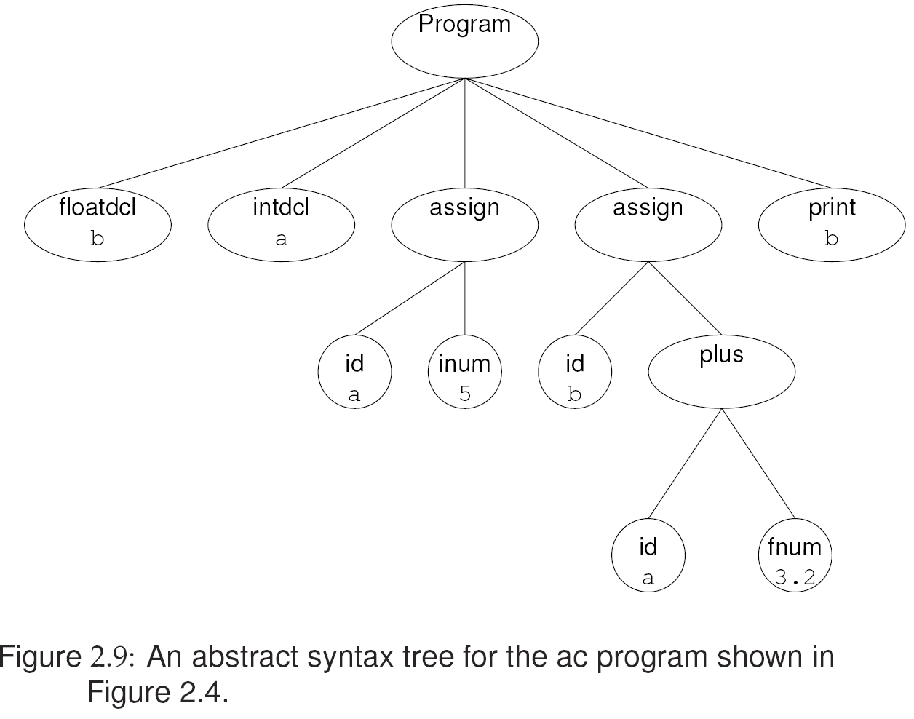
Type Analysis for ac
At each AST node, VISIT() is called:
  For constants and symbol references, the visitor methods simple set the supplied node’s type based on the node’s contents
  Constant: IntConsting & FloatConsting
  Symbol: SymReferencing
  For nodes that compute value, such as plus and minus, the appropriate type is computed by calling the utility methods
  For an assignment operation, the visitor makes certain that the value computed by the second child is of the same type as the assigned identifier (the first child)
  → n.child1 = n.child2

Slide 43
Type Analysis for ac
CONSISTENT() is responsible for reconciling the type of a pair of AST nodes with the following steps:
  The GENERALIZE() function determines the least general (i.e., simplest) type that encompasses its supplied pair of types
  In ac, if either type is float, then float is the appropriate type; otherwise, integer will do
  The CONVERT() procedure checks whether conversion is necessary, possible, or impossible
An important consequence occurs at Marker 13 in Figure 2.12
  If conversion is attempted from integer to float, then the AST is transformed to represent this type conversion explicitly
  Subsequent compiler passes (particularly code generation) can then assume a type-consistent AST in which all operations are explicit

Slide 44
Code Generation
The final task undertaken by a compiler
  → The formulation of target-machine instructions that faithfully represent the semantics (i.e.,meaning) of the source program
  Translation exercise of the textbook consists of generating source code that is suitable for the dc program, which is a simple calculator based on a stack machine model
In a stack machine, most instructions receive their input from the contents at or near the top of an operand stack
  The result of most instructions is pushed on the stack
  Programming languages such as C# and Java are frequently translated into a portable, stack machine representation
  Check Ch.11 and Ch.13

Slide 45
Code Generation (Cont’d)
The AST was transformed and decorated with type information during semantic analysis
  Such information is required for selecting the proper instructions
The instruction set on most computers distinguishes between float and integer data types
  ARM processors have the instructions
    VADD for Floating-point Add
    VDIV for Floating-point Divide
    ADD for Integer Add
    SDIV for Signed Divide

Slide 46
Generating Code for ac
Traverse the AST
  starting at its root and working toward its leaves
The code generator is called recursively
  to generate code for the left and right subtrees
  The resulting values will be at top-of-stack
VISIT(Computing n)
  generates code for plus and minus
  The appropriate operator is then emitted (Marker 15) to perform the operation

Slide 47
Generating Code for ac (Cont’d)
VISIT (Assigning n)
  E.g., the expression
  a = 5 is evaluated
  Code is then emitted to store the value in the appropriate dc register, a
  The calculator’s precision is then reset to integer by setting the fractional precision to zero (Marker 14)
5
s
a
0k

Slide 48
Generating Code for ac
VISIT (Computing n)
  generates code for the computation: plus or minus
  The appropriate operator is then emitted (Marker 15) to perform the operation

Slide 49
Generating Code for ac (Cont’d)
VISIT (SymReferencing n)
  causes a value to be retrieved from the appropriate dc register and pushed onto the stack
  Push register
  → Load (l) symbol (a) to dc register
  → `la’

Slide 50
Generating Code for ac (Cont’d)
VISIT (Printing n)
  is tricky because dc does not discard the value on top-of-stack after it is printed
  The instruction sequence `si’ is generated at Marker 16,
  thereby popping the stack and storing the value in dc’s i register
  Conveniently, the ac language precludes a program from using this register because the i token is reserved for spelling the terminal symbol integer

Slide 51
Generating Code for ac (Cont’d)
VISIT (Converting n)
  causes a change of type from integer to float at Marker 17,
  which accomplished by setting dc’s precision to five fractional decimal digits → `5 k’

Slide 52
Generating Code for ac (Cont’d)

Slide 53
Questions?

